Slide 1
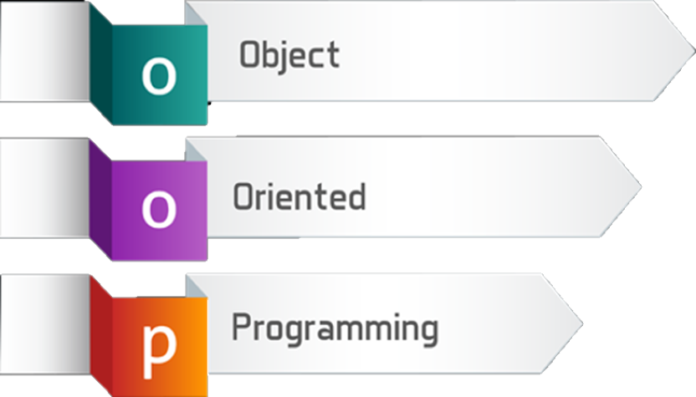
Defining Classes
Classes, Fields, Constructors, Properties, Methods
SoftUni Team
Technical Trainers
Software University
https://about.softuni.bg/

Slide 2
Table of Contents
Defining Simple Classes
Fields and Properties
Methods
Constructors
Enumerations
Static Classes
Namespaces

Slide 3
Have a Question?
sli.do
#csharp-advanced

Slide 4

Defining Simple Classes
Creating Class for an ADT

Slide 5
Defining Simple Classes
Class is a concrete implementation of an ADT
Classes provide structure for describing and creating objects
Keyword
Class name
class Dice
{
…
}
Class body
5

Slide 6


Naming Classes
Name classes with nouns using PascalCasing
Use descriptive nouns
Avoid abbreviations (except widely known, e.g. URL, HTTP, etc.)
class Dice { … }
class BankAccount { … }
class TPMF { … }
class bankaccount { … }
class intcalc { … }
6

Slide 7
Class Members
Members are declared in the class and they have certain accessibility, which can be specified
They can be:
Fields
Properties
Methods, etc.
class Dice
{
int sides;
string Sides {get;}
void Roll(){ … }
}
Field
Property
Method
7

Slide 8

Creating an Object
A class can have many instances (objects)
class Program
{
public static void Main()
{
Dice diceD6 = new Dice();
Dice diceD8 = new Dice();
}
}
Use the new keyword
A variable stores a reference
8

Slide 9
Object Reference
Declaring a variable creates a reference in the stack
The new keyword allocates memory on the heap
Dice diceD6 = new Dice();
STACK
HEAP
obj
diceD6
(1540e19d)
type = null
sides = 0
9

Slide 10
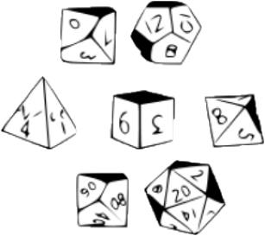

Classes vs. Objects
Classes provide structure for describing and creating objects
An object is a single instance of a class
Dice is…
Dice ADT
Dice (Class)
D6 Dice (Object)
10

Slide 11
Classes vs. Objects
Classes provide structure for creating objects
An object is a single instance of a class
class
Dice
Object name
Class name
object diceD6
type: string
sides: int
Class data
type = "six sided"
sides = 6
Roll(…)
Class actions
Object data
11

Slide 12

Fields and Properties
Storing Data Inside a Class

Slide 13
Fields and Modifiers
Class fields have type and name
Modifiers define accessibility
Class modifier
public class Dice
{
private string type;
private int sides;
private int[] rollFrequency;
private Person owner;
public void Roll () { … }
}
Fields should always be private
Fields can be of any type
13

Slide 14
Properties
Used to create accessors and mutators (getters and setters)
public class Dice
{
private int sides;
public int Sides
{
public get { return this.sides; }
public set { this.sides = value; }
}
}
The field is hidden
The getter provides access to the field
The setter provides field change
14

Slide 15

Problem: Car
Create a class Car
private string make;
private string model;
private int year
public string Make
{
get { return this.make; }
set { this.make = value; }
}
// TODO: Balance and Year Getter & Setter
Car
-make:string
-model:string
-year:int
(no actions)
15

Slide 16

Methods
Defining a Class Behaviour

Slide 17
Methods
Store executable code (an algorithm)
public class Dice
{
private int sides;
private Random rnd = new Random();
public int Roll() {
int rollResult = rnd.Next(1, this.sides + 1);
return rollResult;
}
}
this points to the current instance
17

Slide 18

Problem: Car Extension
Create a class Car
Car
-make:string
-model:string
-year:int
-fuelQuantity:double
-fuelConsumption:double
+Drive(double distance):void
+WhoAmI():string
Check your solution here: https://judge.softuni.bg/Contests/1478/Defining-Classes-Lab
18

Slide 19
Solution: Car Extension (1)
// TODO: Get the other fields from previous problem
private double fuelQuantity;
private double fuelConsumption;
// TODO: Get the other properties from previous problem
public double FuelQuantity {
get { return this.fuelQuantity; }
set { this.fuelQuantity = value; }}
public double FuelConsumption {
get { return this.fuelConsumption; }
set { this.fuelConsumption = value; }}
19

Slide 20
Solution: Car Extension (2)
public void Drive(double distance)
{
bool canContinue = this.FuelQuantity – (distance * this.FuelConsumption) >= 0;
if(canContionue)
this.FuelQuantity -= distance * this.FuelConsumption;
else
Console.WriteLine("Not enough fuel to perform this trip!");
}
20

Slide 21
Solution: Car Extension (3)
public string WhoAmI()
{
StringBuilder sb = new StringBuilder();
sb.AppendLine($"Make: {this.Make}");
sb.AppendLine($"Model: {this.Model}");
sb.AppendLine($"Year: {this.Year}");
sb.Append($"Fuel: {this.FuelQuantity:F2}L");
return sb.ToString();
}
21

Slide 22


Constructors
Object Initialization

Slide 23
Constructors
When a constructor is invoked, it creates an instance of its class and usually initializes its members
Classes in C# are instantiated with the keyword new
public class StartUp
{
static void Main()
{
var dice = new Dice();
}
}
public class Dice
{
public Dice() { }
}
23

Slide 24
Object Initial State
Constructors set object's initial state
public class Dice
{
int sides;
int[] rollFrequency;
public Dice(int sides) {
this.sides = sides;
this.rollFrequency = new int[sides];
}
}
Always ensure correct state
24

Slide 25
Multiple Constructors
You can have multiple constructors in the same class
public class Dice
{
private int sides;
public Dice() { }
public Dice(int sides)
{
this.sides = sides;
}
}
Constructor without parameters
Constructor with parameters

Slide 26
Constructor Chaining
Constructors can call each other
public class Person {
private string name;
private int age;
public Person() {
this.age = 18;
}
public Person(string name) : this() {
this.name = name;
}
}
Calls default constructor

Slide 27
Problem: Car Constructors
Extend the previous problem and create 3 constructors
Default values are:
Make - VW
Model - Golf
Year - 2025
FuelQuantity = 200
FuelConsumption = 10
Car
+Car()
+Car(string make, string model, int year)
+Car(string make, string model, int year, double fuelQuantity, double fuelConsumption)
Check your solution here: https://judge.softuni.org/Contests/Practice/Index/1478#2
27

Slide 28
Solution: Car Constructors (1)
public Car() {
this.Make = "VW";
this.Model = "Golf";
this.Year = 2025;
this.FuelQuantity = 200;
this.FuelConsumption = 10;}
public Car(string make, string model, int year) : this() {
this.Make = make;
this.Model = model;
this.Year = year;}
28

Slide 29
Solution: Car Constructors (2)
public Car(string make, string model, int year, double fuelQuantity, double fuelConsumption)
: this(make, model, year)
{
this.FuelQuantity = fuelQuantity;
this.FuelConsumption = fuelConsumption;
}
29

Slide 30
Problem: Car Engine and Tires
Create the two classes and extend the Car class
Engine
Tire
-horsePower:int
-cubicCapacity:double
-year:int
-pressure:double
+Engine(int horsePower, double cubicCapacity)
+Engine(int year, double pressure)
Car
+Car(string make, string model, int year, double fuelQuantity, double fuelConsumption, Engine engine, Tire[] tires)
Check your solution here: https://judge.softuni.org/Contests/Practice/Index/1478#3

Slide 31
Solution: Car Engine and Tires (1)
private int horsePower;
private double cubicCapacity;
public Engine(int horsePower, double cubicCapacity) {
this.HorsePower = horsePower;
this.CubicCapacity = cubicCapacity; }
public int HorsePower {
get { return this.horsePower; }
set { this.horsePower = value; }}
public double CubicCapacity {
get { return this.cubicCapacity; }
set { this.cubicCapacity = value; }}
31

Slide 32
Solution: Car Engine and Tires (2)
private int year;
private double pressure;
public Tire(int year, double pressure) {
this.Year = year;
this.Pressure = pressure; }
public int Year {
get { return this.year; }
set { this.year = value; }}
public double Pressure {
get { return this.pressure; }
set { this.pressure = value; }}
32

Slide 33
Solution: Car Engine and Tires (3)
public Car(string make, string model, int year, double fuelQuantity, double fuelConsumption, Engine engine, Tire[] tires)
: this(make, model, year, fuelQuantity, fuelConsumption)
{
this.Engine = engine;
this.Tires = tires;
}
33

Slide 34

Enumerations
Syntax and Usage

Slide 35
Enumerations (1)
Represent a numeric value from a fixed set as a text
We can use them to pass arguments to methods without making code confusing
By default enums start at 0
Every next value is incremented by 1
enum Day { Mon, Tue, Wed, Thu, Fri, Sat, Sun }
GetDailySchedule(0)
GetDailySchedule(Day.Mon)
35

Slide 36




Enumerations (2)
We can customize enum values
enum Day {
Mon = 1,
Tue, // 2
Wed, // 3
Thu, // 4
Fri, // 5
Sat, // 6
Sun // 7
}
enum CoffeeSize
{
Small = 100,
Normal = 150,
Double = 300
}

Slide 37

Static Classes
Static Class Members

Slide 38
Static Class
A static class is declared by the static keyword
It cannot be instantiated
You cannot declare variables from its type
You access its members by using the its name
double roundedNumber = Math.Round(num);
int absoluteValue = Math.Abs(num);
int pi = Math.PI;
38

Slide 39
Static Members (1)
Both static and non-static classes can contain static members:
Methods, fields, properties, etc.
A static member is callable on a class even when no instance of the class has been created
Аccessed by the class' name, not the instance name
Only one copy of a static member exists, regardless of how many instances of the class are created
39

Slide 40
Static Members (2)
Static methods can be overloaded but not overridden
A const field is essentially static in its behavior and it belongs to the type, not the instance
Static members are initialized before the static member is accessed for the first time and before the static constructor
Bus.Drive();
int wheels = Human.NumberOfWheels;

Slide 41
Example: Static Members
public class Engine
{
public static void Run() {
Console.WriteLine("This is a static method"); }
}
public static void Main() {
Engine.Run();
}
// Output: This is a static method

Slide 42

Namespaces
Definition and Usage

Slide 43
Namespaces
Used to organize classes
The using keyword allows us not to write their names
Declaring your own namespaces can help you control the scope of class and method names
System.Console.WriteLine("Hello world!");
var list = new
System.Collections.Generic.List<int>();
43

Slide 44

Summary
…
…
…
Classes define structure for objects
Objects are instances of a class
Classes define fields, methods, constructors and other members
Constructors:
Invoked when creating new instances
Initialize the object's state

Slide 45
Questions?
Notes:
45

Slide 46










SoftUni Diamond Partners

Slide 47



Educational Partners

Slide 48
Trainings @ Software University (SoftUni)
Software University – High-Quality Education, Profession and Job for Software Developers
softuni.bg, about.softuni.bg
Software University Foundation
softuni.foundation
Software University @ Facebook
facebook.com/SoftwareUniversity
Software University Forums
forum.softuni.bg
48
Notes:
48

Slide 49

License
This course (slides, examples, demos, exercises, homework, documents, videos and other assets) is copyrighted content
Unauthorized copy, reproduction or use is illegal
© SoftUni – https://about.softuni.bg/
© Software University – https://softuni.bg
Notes:
49

